Slide 1
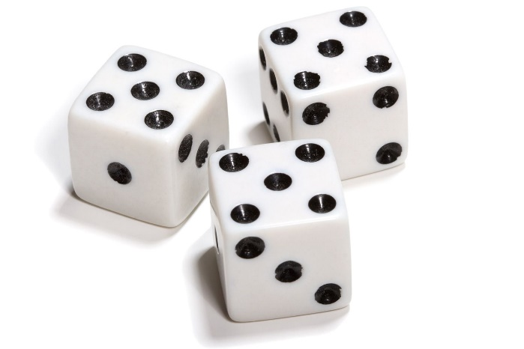


My Probability Interactive Notebook
Name
Class
Teacher
Term 4 Semester 2
1

Slide 2
Contents
Glossary or Formula Page
Page
Date
Description
Open to your glossary and write down the following definitions.
2
3

Slide 3
24
7
30
Probability Review
Date
EQ – How can we use probability language when building two-way tables and Venn Diagrams?
First, a review of some key terms.....
5

Slide 4
Probability Experiment
A probability experiment is a where chance affects the result of that activity.
Rolling a fair die is a probability experiment.

Slide 5
Outcome
An outcome is a possible result for a probability experiment.
Rolling a 3 is a possible outcome for rolling a fair die.

Slide 6
Sample Space
The sample space is the set of all possible outcomes for a probability experiment.
The sample space for rolling a fair die is 1-6
It is written like this S: {1, 2, 3, 4, 5, 6}

Slide 7
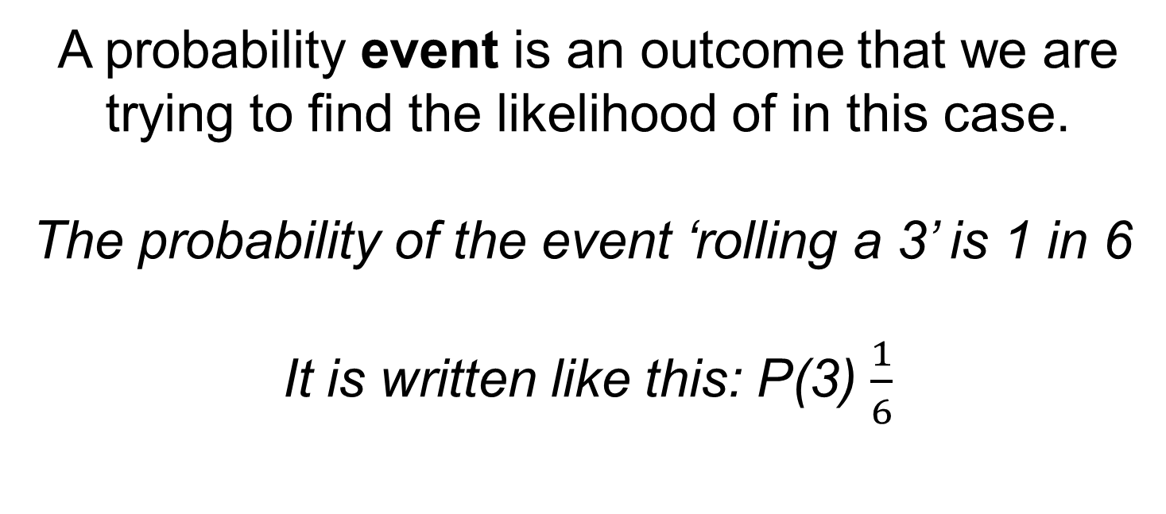
Event
A probability event is an outcome that we are trying to find the likelihood of in this case.
The probability of the event ‘rolling a 3’ is 1 in 6
It is written like this: P(3) $\frac{1}{6}$

Slide 8
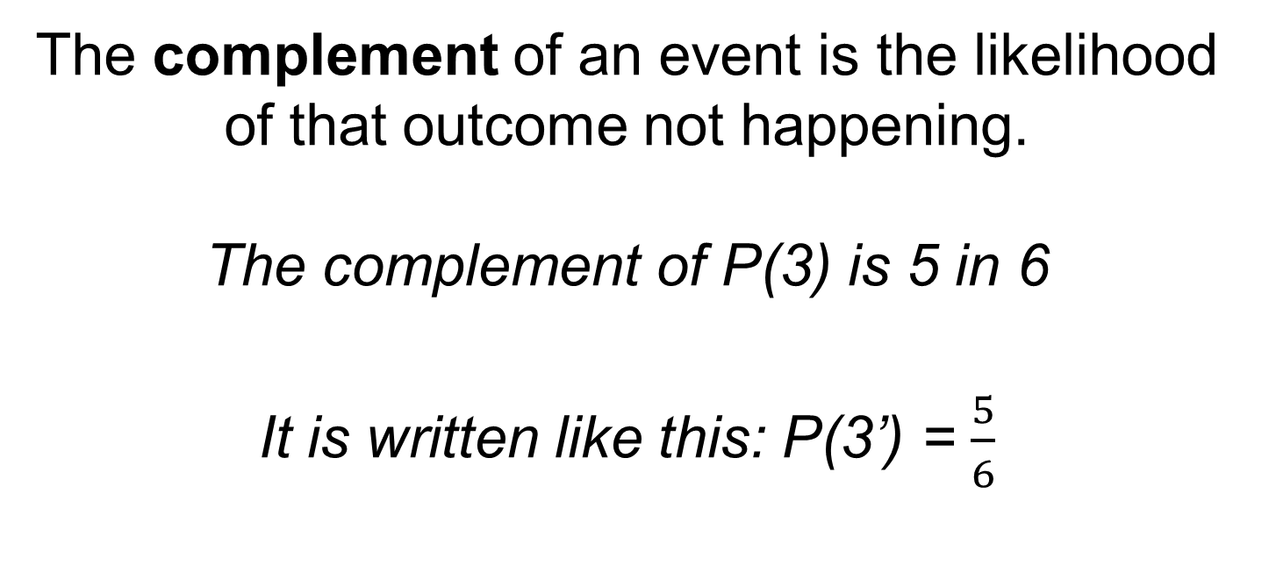
Complement
The complement of an event is the likelihood of that outcome not happening.
The complement of P(3) is 5 in 6
It is written like this: P(3’) = $\frac{5}{6}$

Slide 9
Trial
A trial is the action of performing a probability experiment once.
In 6 trials, the outcome of rolling a 3 was obtained once.

Slide 10




24
7
30
Probability Review
Date
EQ – How can we use probability language when building two-way tables and Venn Diagrams?
We can place probabilities on a line from 0 to 1.
What are the different ways we can express probability?
Unlikely Likely
0 _____________________0.5_____________________ 1
Impossible As likely as not Certain
We can write probabilities as a fraction, decimal or percentage.
A bag contains 4 coloured balls: 2 red, 1 blue, 1 yellow.
Sample Space
$$S= \left\{red, red, blue, yellow\right\}$$
One ball is blue
Probability
$$P\left(blue\right)= \frac{1}{4} or 0.25$$
$$P\left(red\right)=\frac{2}{4}=\frac{1}{2} or 0.5$$
Event
4 possible outcomes
We can calculate the complement of an event (eg not a 3) by subtracting the probability of an event from one.
$$P\left(blue′\right)=1 − \frac{1}{4}=\frac{3}{4} or 0.75$$
$$P\left(red′\right)=1 −0.5=0.5 or 50\%$$
Complement of event
Three balls are not blue

Slide 11
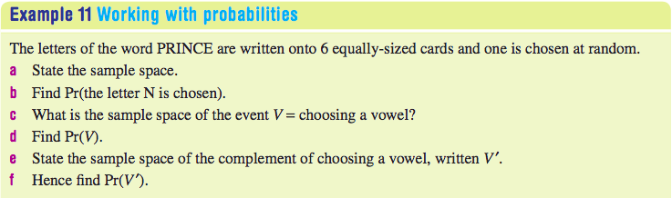
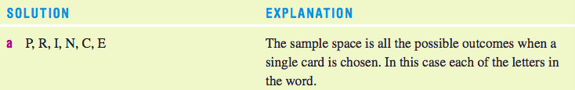




Slide 12
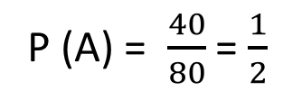
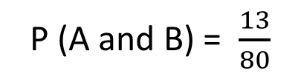
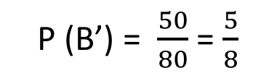
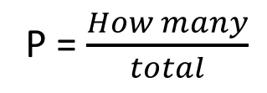
24
7
30
Probability Review
Date
EQ – How can we use probability language when building two-way tables and Venn Diagrams?
Two-way tables lists the number of outcomes (or people) in different categories, with totals at the bottom. We display them like this:
Not A
 |  | Event A
 |  | A | A’ | Total
Event B | B
 | B’
 | Total
13
17
30
27
23
50
40
40
80
P = $\frac{How many}{total}$
P (A) = $\frac{40}{80}$ = $\frac{1}{2}$
P (A and B) = $\frac{13}{80}$
P (B’) = $\frac{50}{80}$ = $\frac{5}{8}$

Slide 13
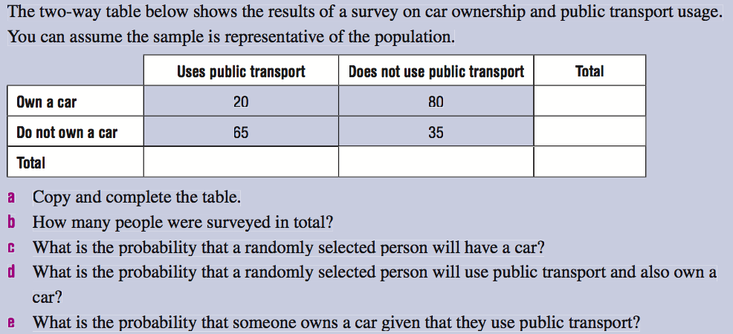
Your turn

Slide 14
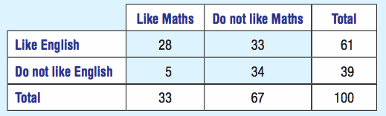
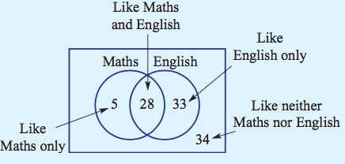
24
7
30
Probability Review
Date
EQ – How can we use probability language when building two-way tables and Venn Diagrams?
A Venn Diagram is a pictorial representation of a two-way table, without the total row and column. Take the following two-way table:
This can be displayed as a Venn Diagram as so:
5

Slide 15
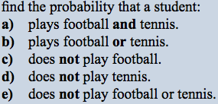
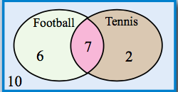
24
7
30
Probability Review
Date
EQ – How can we use probability language when building two-way tables and Venn Diagrams?
a) 7/25
b) 15/25 or 3/5
c) 12/25
d) 16/25
e) 10/25 or 2/5
5

Slide 16

Do you understand?
Notes:
Check for Understanding

Slide 17
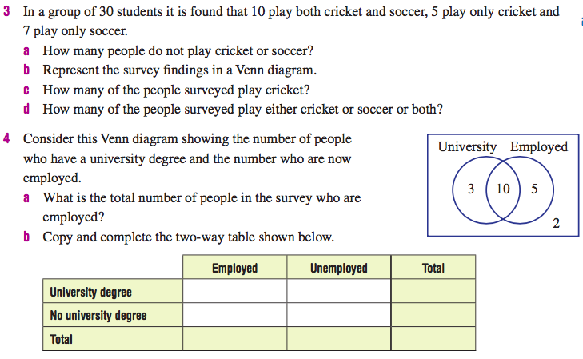
Your Turn

Slide 18
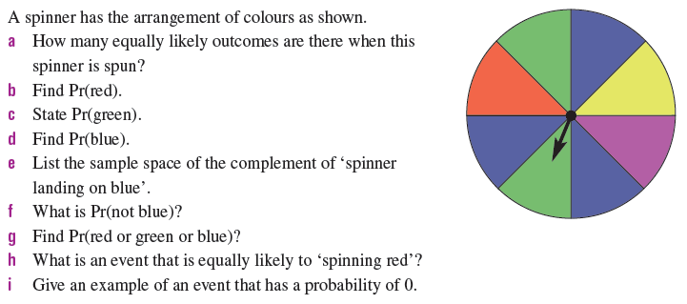
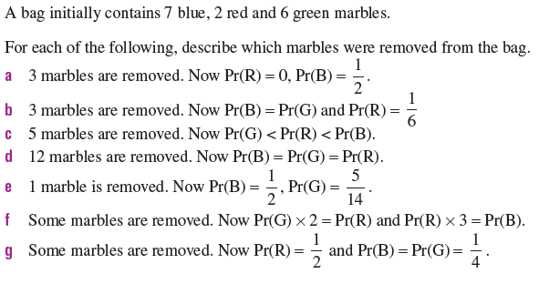
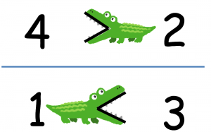
Challenge For Fast Finishers
Crocodiles eat the big things!

